Slide 1
Electrostatics

Slide 2
Electric Field due to Charge Distribution
Applications
Line charge (finite and infinite line)
Surface charge density

Slide 4
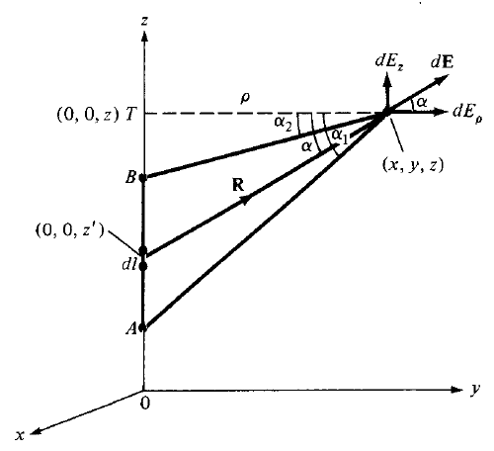




Electric field due to a Line Charge
Consider a line charge with uniform charge density ρ_{L} extending from A to B along the z-axis.
The charge element dQ associated with element dl = dz of the line is
The total charge Q is
The electric field intensity E at an arbitrary point P (x, y, z) can be given by
The field point is generally denoted by (x, y, z) and the source point as (x’, y’, z’). So from fig…

Slide 5





Electric Field Intensity due to Line Charge
Further R may be written as;
Hence intensity equation becomes

Slide 6


Electric Field Intensity due to Line Charge
To evaluate this, we should define α, α₁ and α₂ as in given fig. ;
From triangle TPdl; Secα = R / ρ so R = ρ Secα or, ρ = R Cosα
or
Further; From triangle TPdl;
tanα = z-z’ / ρ
So, z-z’ = ρ tanα
or, z’ = z - ρ tanα
or, z’ = OT - ρ tanα
or, dz’ = - ρ sec²α d α
putting these values in last equ.

Slide 7



Electric Field Intensity due to Line Charge
Or,
So for a finite line charge, we have;
So as a special case, for an finite line charge, if point B is at (0,0,∞) and A is at (0,0,-∞). Then α₁ = π/2 and α₂ = -π/2. So z-component will vanish then we have;

Slide 9
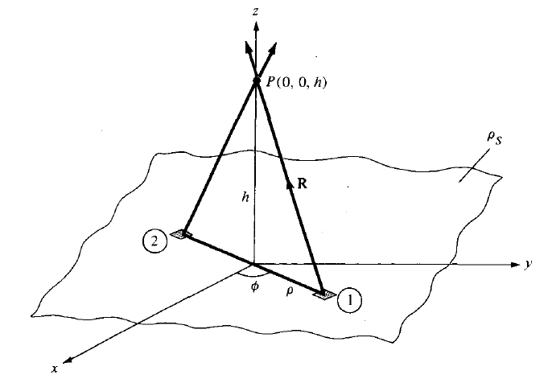


Electric Field Intensity due to Surface Charge
Consider an infinite sheet of charge in the xy plane with uniform charge density ρ_{S}. The charge associated with an elemental area dS is
and hence total charge is
The contribution to Electric Field at Point P (0, 0, h) by the elemental surface is

Slide 10





Electric Field Intensity due to Surface Charge
Substitution of these terms in Electric Field equation gives

Slide 11




Electric Field Intensity due to Surface Charge
Due to the symmetry of charge distribution, for every element 1, there is a corresponding element 2 whose contribution along a_{ρ} cancels that of element 1.
So, E has only z-component
In general for an infinite sheet of charge

Slide 13

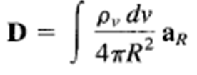
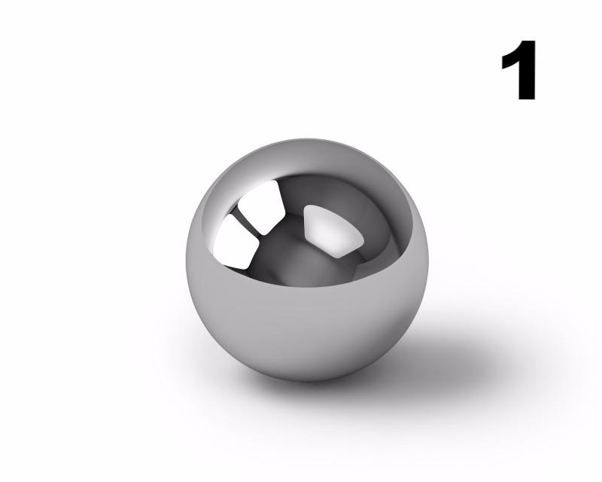
Electric Flux Density
The electric field intensity depends on the medium in which the charges are placed.
Suppose a vector field D independent of the medium is defined by
The electric flux ψ in terms of D can be defined as
The vector field D is called the electric flux density and is measured in coulombs per square meter.
For an infinite sheet the electric field intensity D is given by
For a volume charge distribution the electric field intensity D is given by
In both the above equations D is a function of charge and position only (independent of medium)

Slide 14
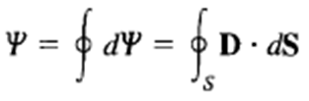


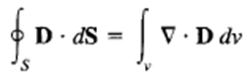
Gauss Law
It states that the total electric flux ψ through any closed surface is equal to the total charge enclosed by that surface.
Using Divergence Theorem
Comparing the two volume integrals
This is the first Maxwell’s equation.
It states that the volume charge density is the same as the divergence of the electric flux density.

Slide 15


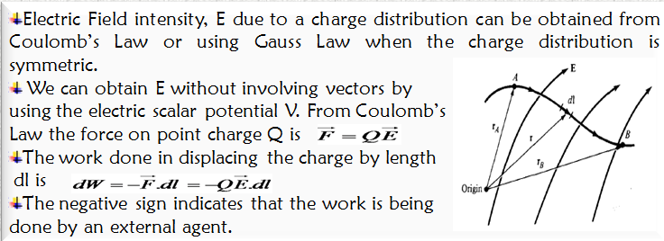
Electric Potential
The potential at any point due to a point charge Q located at the origin is
The potential at any point is the potential difference between that point and a chosen point at which the potential is zero.
Assuming zero potential at infinity, the potential at a distance r from the point charge is the work done per unit charge by an external agent in transferring a test charge from infinity to that point.

Slide 16
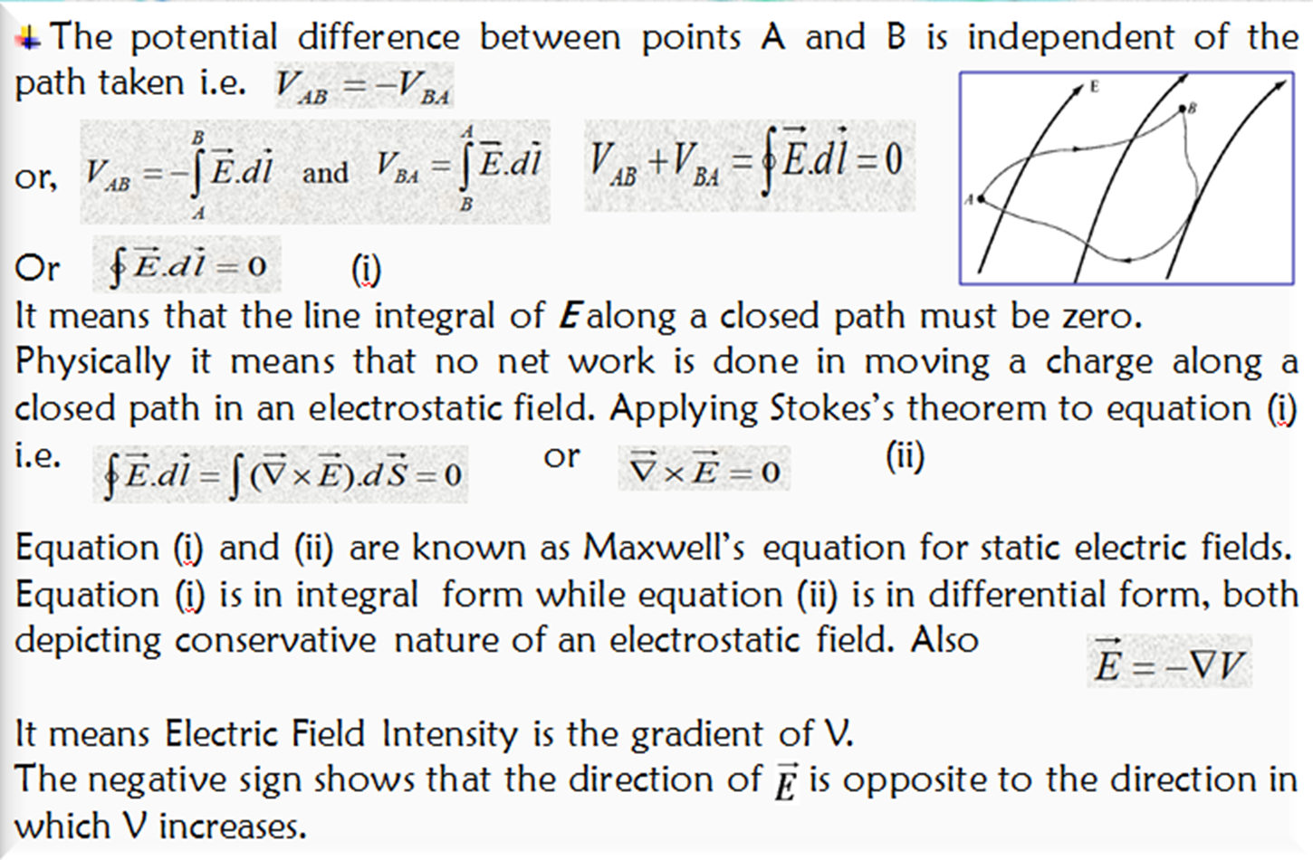
Relationship between E and V

Slide 17
E and V relation

Slide 18
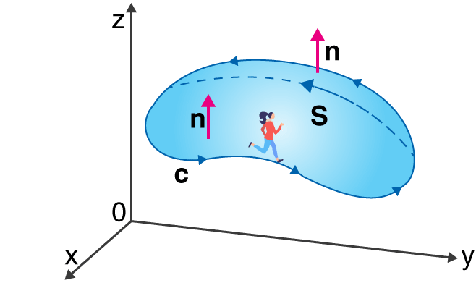
Stokes Theorem
The surface integral of the curl of a function over a surface bounded by a closed surface is equal to the line integral of the particular vector function around that surface.

